Slide 1
M9

Slide 2
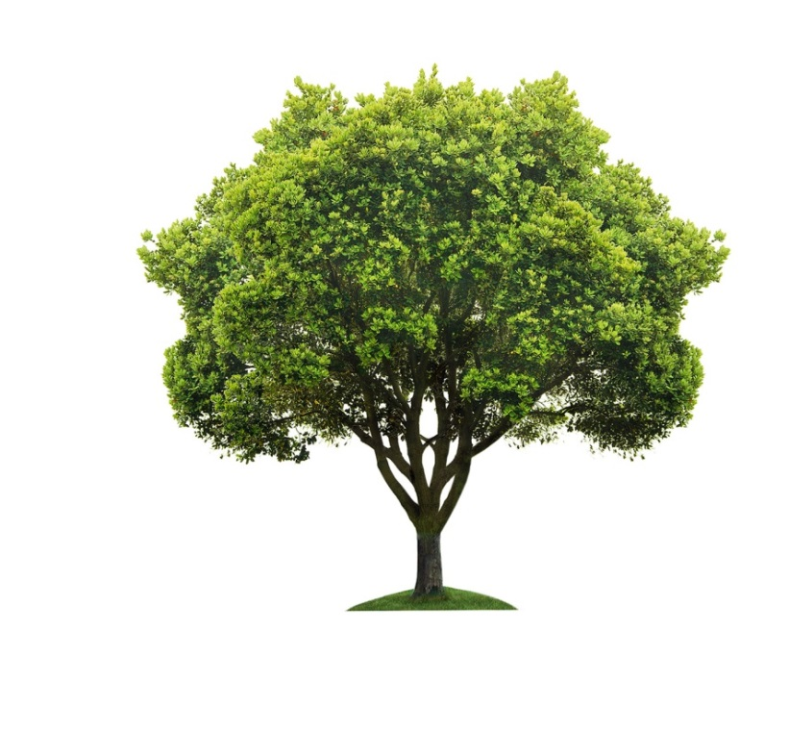
Biogeochemical cycle
These interactions consist of transfer of matter and energy between the different components of the biosphere.
A constant interaction between the biotic and abiotic components of the biosphere makes it a dynamic, but stable system.
Carbon
cycle
Biosphere
Nitrogen
cycle
Atmosphere
Water
cycle
Oxygen
cycle
Lithosphere
Hydrosphere

Slide 3
Biogeochemical cycle
There are various cycles such as water cycle, nitrogen cycle, carbon cycle, oxygen cycle.
This interaction occurs through different cycles called biogeochemical cycles.
C
o
o
O
Biosphere
N
N
Atmosphere
H
H
Lithosphere
O
O
Hydrosphere

Slide 4
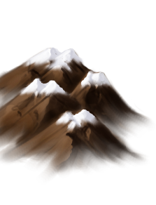

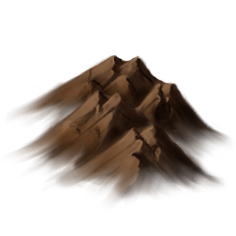

Water cycle
You have seen how the water evaporates from the water bodies.
But we don’t see the seas and oceans drying up.
When water evaporates, it condenses to form clouds which ultimately give rain.
Most of this rain water is carried by small water bodies like rivers into oceans and seas.
But all of the water that flows on the land does not immediately flow back into the sea.
Some of it seeps into the soil and become part of the underground reservoir of fresh water.
So, how is water returning to these water bodies?

Slide 5
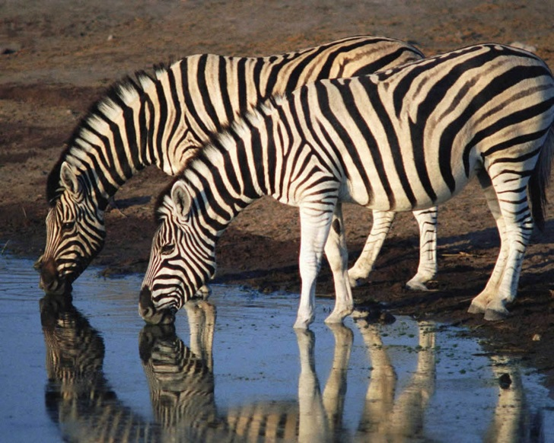
The water cycle
Some of this underground water finds its way to the surface through springs.
Or we bring it to the surface for our use through wells or tube wells.
Water is also used by terrestrial animals and plants for various life process.

Slide 6

The water cycle
So, how do we define water cycle?
The whole process in which water evaporates and falls on the land as rain and later flows back into the sea via rivers is known as the water-cycle.

